Slide 1

DEPARTMENT OF COMPUTER SCIENCE AND ENGINEERING
Title: Academic Records Validator Using Blockchain Technology
BATCH ID : 23MPCS-H11
S. No | Roll. No | Student Name
1 | 23881A05FH | G.YASHASWINI
2 | 23881A05FU | K. TRIVIKRAM
3 | 23881A05GF | N.LAALU NAIK
Guide Details
Dr. V. Mohan
Assistant Professor
Department of CSE

Slide 2
Mini Project Outlines
Introduction
Existing System Vs Proposed
Research Gaps
Problem Statement
Proposed Project Objectives
Proposed Project Outcomes
Software and Hardware Requirements
Architectural Diagram
Proposed Methods and Algorithms
Results
Research Paper (Acceptance Proofs)
Conclusion

Slide 3
Introduction
In today’s digital world, verifying academic certificates is essential for education and employment, but the rise of fake certificates has made this process challenging. Traditional verification methods are often manual, slow, and unreliable.
The Academic Records Validator is designed to provide a secure and automated solution for validating multiple academic documents such as 10th, Intermediate, and Degree certificates. The system uses technologies like OCR to extract certificate details, generates a unique hash using SHA-256, and stores it on a blockchain to ensure data integrity.
During verification, the system compares the regenerated hash with the stored blockchain record to determine authenticity. This approach makes the process faster, more reliable, and resistant to tampering, helping institutions and organizations detect fraudulent certificates efficiently.
This project aims to provide a reliable, automated, and scalable solution that reduces verification time, minimizes fraud, and enhances trust in academic credential systems. It is particularly useful for universities, employers, and verification agencies seeking a secure and efficient validation process.

Slide 4
Existing System Vs Proposed
1. Existing Systems
Current certificate verification methods are mostly manual or use centralized databases. These approaches are slow, prone to errors, and can be manipulated.
Some systems use QR codes for verification, but they still have security limitations.
Additionally, many existing solutions do not support verification of multiple academic records together, making the process incomplete and inefficient.
2. Proposed Solution
The Academic Records Validator provides a secure and automated way to verify academic certificates. It extracts key details from certificates using OCR, generates a unique hash using SHA-256, and stores the hash on a blockchain.
During verification, the system regenerates the hash from the uploaded certificate and compares it with the stored blockchain record. If both match, the certificate is genuine; otherwise, it is flagged as fake. This ensures fast, reliable, and tamper-proof validation of academic records.
DEPARTMENT OF CSE : MINI PROJECT

Slide 5
Research Gaps
Existing certificate verification systems have several limitations. They are often manual, time-consuming, and prone to human errors. Many systems rely on centralized databases, which are vulnerable to data tampering and security breaches.
There is a lack of strong mechanisms to ensure data integrity and authenticity. Current solutions also do not provide a fully automated process and fail to support verification of multiple academic records in a single system.
Additionally, there is limited use of advanced technologies like blockchain and hashing, resulting in lower trust, transparency, and reliability.
Another key gap is the lack of effective use of OCR and AI, which limits automatic data extraction and advanced fraud detection capabilities.
Furthermore, many systems lack standardization across institutions, making it difficult to uniformly verify certificates from different boards or universities.
DEPARTMENT OF CSE : MINI PROJECT

Slide 6
Problem Statement
The increasing number of fake and tampered academic certificates has become a major challenge for institutions, employers, and verification agencies. Existing verification methods are mostly manual or depend on centralized systems, making them slow, error-prone, and vulnerable to data manipulation.
Moreover, current solutions lack automation and fail to effectively use technologies like OCR and AI for data extraction and fraud detection. They also do not support verification of multiple academic records in a single system and lack standardization across different institutions.
As a result, the verification process becomes time-consuming, costly, and unreliable. Therefore, there is a need for a secure, automated, and scalable system that ensures fast, accurate, and tamper-proof validation of academic credentials.
DEPARTMENT OF CSE : MINI PROJECT

Slide 7
Proposed Project Objectives
To develop a secure and automated system that simplifies the process of verifying academic certificates and reduces dependency on manual verification methods.
To extract essential information such as name, roll number, certificate ID, institution name, and year of passing from certificates using OCR technology for accurate data processing.
To generate a unique cryptographic hash for each certificate using the SHA-256 algorithm, ensuring that every document has a distinct and secure digital identity.
To store the generated hash on a blockchain network, which provides a tamper-proof and transparent mechanism for maintaining certificate authenticity.
To implement a verification mechanism where the system compares the regenerated hash of an uploaded certificate with the stored blockchain hash to determine its genuineness.
To support the validation of multiple academic records, including 10th, Intermediate, and Degree certificates, within a single integrated platform.
To reduce the overall verification time and minimize human errors by automating the entire validation process.
DEPARTMENT OF CSE : MINI PROJECT

Slide 8
Proposed Project Outcomes
The system will provide a secure and reliable platform for verifying academic certificates, reducing the chances of fraud and fake documents.
It will enable faster and automated verification, significantly decreasing the time required compared to manual methods.
The use of blockchain will ensure data integrity and tamper-proof storage, increasing trust among institutions and employers.
The system will support verification of multiple academic records in a single platform, making the process more efficient and convenient.
By using OCR and AI, the system will achieve accurate data extraction and improved fraud detection.
Overall, the project will enhance transparency, efficiency, and reliability in academic credential verification.
DEPARTMENT OF CSE : MINI PROJECT

Slide 9
Software and Hardware Requirements
Software Requirements
Programming Languages & Platforms: Python , Node.js
Backend (Python): Flask, TensorFlow, NumPy, Pandas, Scikit-learn, Web3.py
AI Module & Workflow:MobileNetV2 , OpenCV + Tesseract
Frontend (React): React 18, Axios , react-scripts
Blockchain: Hardhat, Solidity (smart contracts) , SHA-256
Hardware Requirements
Processor: Minimum i3, Recommended i5/i7 or Ryzen 5/7
RAM: Minimum 8 GB, Recommended 16 GB
Storage: Minimum 10 GB, Recommended 20+ GB (SSD preferred)
GPU (Optional): NVIDIA GPU for faster AI processing
Network: Stable internet for setup and blockchain operations
DEPARTMENT OF CSE : MINI PROJECT

Slide 10
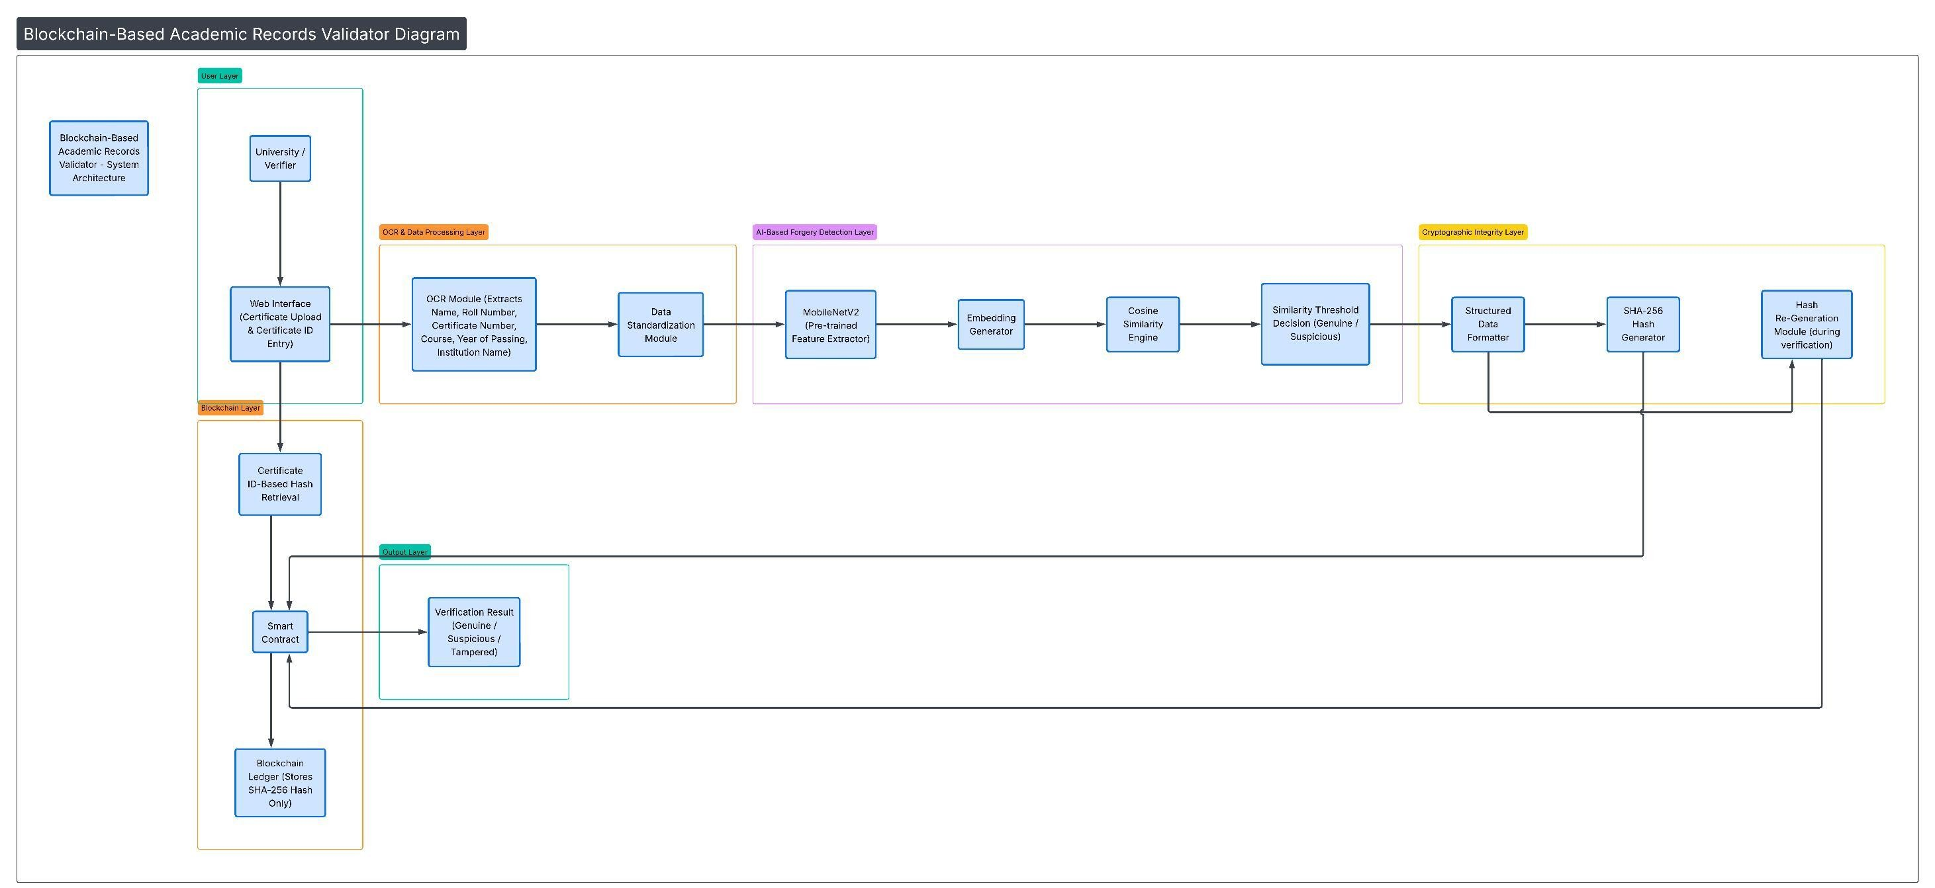
Architectural Diagram
DEPARTMENT OF CSE : MINI PROJECT

Slide 11
PROPOSED METHOD AND ALGORITHMS
Optical Character Recognition (OCR) Algorithm Used to extract text and important details (name, roll number, certificate ID, etc.) from certificate images or PDFs.
Image Preprocessing Algorithms (OpenCV) Techniques like grayscale conversion, noise removal, and thresholding are used to improve the accuracy of OCR.
SHA-256 Hashing Algorithm Generates a unique digital hash for the extracted certificate data, ensuring data security and integrity.
Blockchain Smart Contract Algorithm Used to store and retrieve the generated hash securely on the blockchain using Solidity.
AI/ML Forgery Detection Algorithms Basic machine learning models are used to detect fake or manipulated certificates.
Hash Comparison Algorithm Compares the regenerated hash of the uploaded certificate with the stored blockchain hash to verify authenticity.
DEPARTMENT OF CSE : MINI PROJECT

Slide 12
Results
The system successfully verifies academic certificates with high accuracy and reliability.
It provides a fast and automated verification process, reducing manual effort and time.
Blockchain ensures secure and tamper-proof storage of certificate data.
OCR accurately extracts important details from certificates for processing.
The AI/ML model helps in detecting forged or manipulated certificates effectively.
The system supports verification of multiple academic records in a single platform.
Overall, it improves efficiency, transparency, and trust in academic credential verification.
DEPARTMENT OF CSE : MINI PROJECT
DEPARTMENT OF CSE : MINI PROJECT

Slide 13
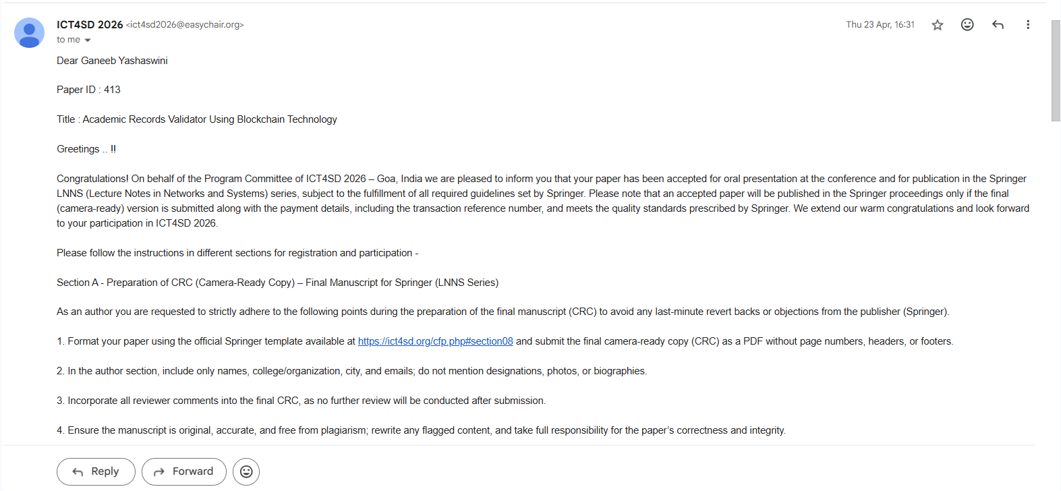
Research Paper (Acceptance Proof)
DEPARTMENT OF CSE : MINI PROJECT

Slide 14
Conclusion
The Academic Records Validator provides a secure, efficient, and automated solution for verifying academic certificates. By integrating OCR for data extraction, AI techniques for forgery detection, and blockchain for tamper-proof storage, the system ensures authenticity and reliability.
The project successfully reduces manual effort, minimizes verification time, and enhances trust in academic credential validation. It also supports verification of multiple records within a single platform, making it practical for real-world use.
Overall, the system demonstrates how modern technologies can be combined to create a robust and scalable solution for detecting fake certificates and improving transparency in the verification process.
DEPARTMENT OF CSE : MINI PROJECT

Slide 15
Thank You
DEPARTMENT OF CSE : MINI PROJECT

